Slide 1
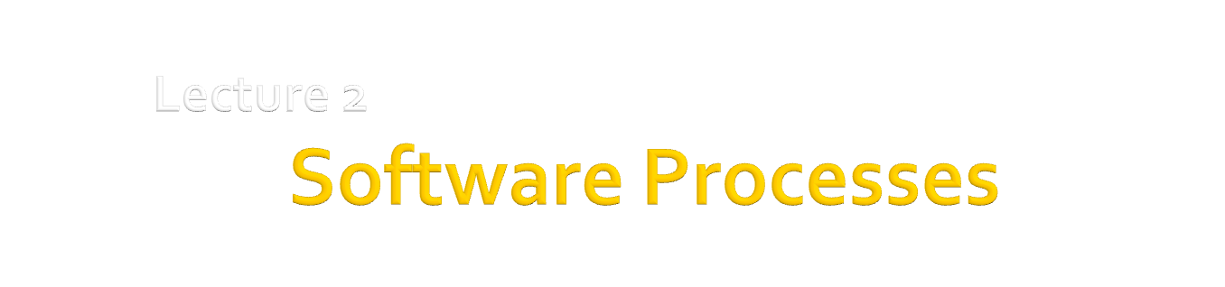
Dr. Hesam Chiniforooshan
se.usc.ac.ir@gmail.com

Slide 2
Objectives
To introduce software process models
To describe three generic process models and when they may be used
To describe outline process models for requirements engineering, software development, testing and evolution

Slide 3
Topics covered
Software process models
Process iteration
Process activities

Slide 4
The software process
A structured set of activities required to develop a software system
Generic SP activities:
Specification
Design & Implementation
Validation
Evolution
A software process model is an abstract representation of a process. It presents a description of a process from some particular perspective.
Feasibility Study
Requirements Engineering
Architecture and Detailed Design
Coding and Module Testing
Integration and System Testing
Delivery, Deployment, and Maintenance

Slide 5
Generic software process models
The waterfall model
Separate and distinct phases of specification and development.
Evolutionary development
Specification, development and validation are interleaved.
Component-based software engineering
The system is assembled from existing components.
There are many variants of these models e.g.
formal development where a waterfall-like process is used but the specification is a formal specification that is refined through several stages to an implementable design.
Agile Development which is an advanced kind of evolutionary model

Slide 6
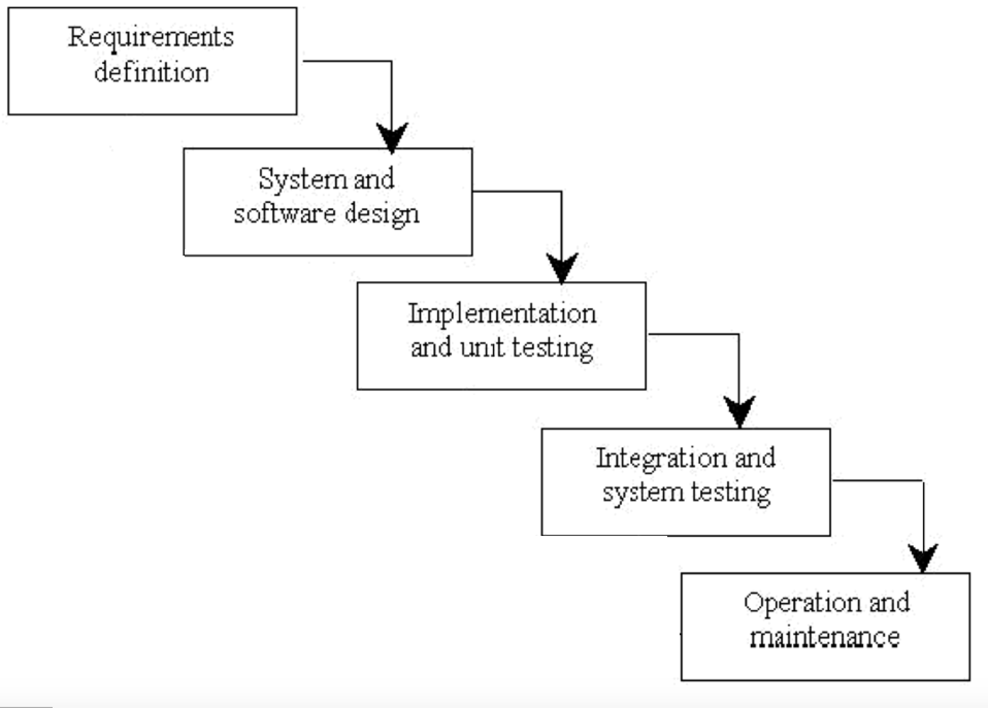
Waterfall model

Slide 7
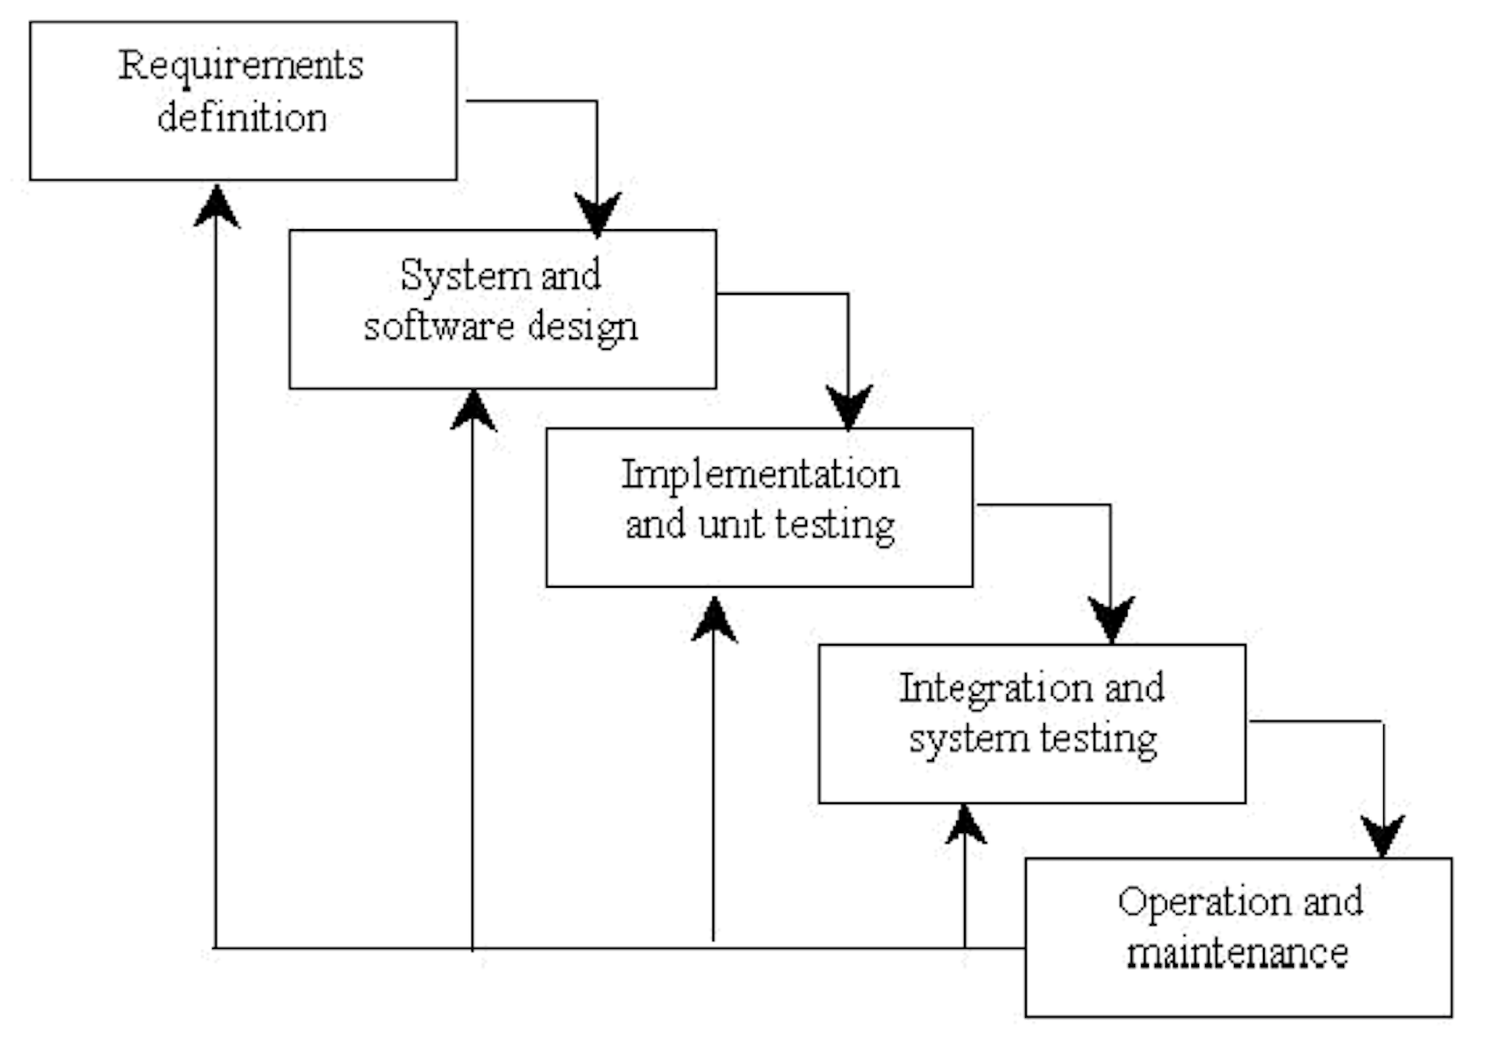
Waterfall model

Slide 8
Waterfall model phases
Requirements analysis and definition
System and software design
Implementation and unit testing
Integration and system testing
Operation and maintenance
The main drawback of the waterfall model is the difficulty of accommodating change after the process is underway. One phase has to be complete before moving onto the next phase.

Slide 9
Waterfall model problems
Inflexible partitioning of the project into distinct stages makes it difficult to respond to changing customer requirements.
Therefore, this model is only appropriate when the requirements are well-understood and changes will be fairly limited during the design process.
Few business systems have stable requirements.

Slide 10
Evolutionary development
Objective is to work with customers and to evolve a final system from an initial outline specification.
Primary Approach: Prototyping
Evolutionary Prototyping
A model of system that forms the heart of the new system, and the improvements and further requirements will be built in addition to it.
Should start with well-understood requirements and add new features as proposed by the customer.
Throw-away prototyping
It is about creating a model of system that will eventually be discarded rather than becoming part of the final delivered software
Objective is to understand the system requirements.
Should start with poorly understood requirements to clarify what is really needed

Slide 11
Evolutionary development

Slide 12
Evolutionary development
Problems
Lack of process visibility;
Systems are often poorly structured;
Applicability
For small or medium-size interactive systems;
For parts of large systems (e.g. the user interface);
For short-lifetime systems.

Slide 13
Component-based software engineering
Based on systematic reuse where systems are integrated from existing components or COTS (Commercial-off-the-shelf) systems; Or collections of objects that are developed as a package to be integrated with a component framework such as .NET or J2EE.
Process stages
Component analysis;
Requirements modification;
System design with reuse;
Development and integration.
This approach is now reforming towards the
Service-Oriented Development.
Instead of tight integration components into the source code, the program will just call for the services, which their implementation is not known and does not matter !!

Slide 14
Reuse-oriented development

Slide 15
Iterative Development
System requirements ALWAYS evolve in the course of a project so process iteration where earlier stages (e.g. requirements analysis) are reworked is always part of the process for large systems.
Iteration can be applied to any of the generic process models.
Two (related) approaches
Incremental delivery
Spiral development

Slide 16
Incremental delivery
Rather than deliver the system as a single delivery, the development and delivery is broken down into increments with each increment delivering part of the required functionality.
User requirements are prioritised and the highest priority requirements are included in early increments.
Once the development of an increment is started, the requirements are frozen (???) though requirements for later increments can continue to evolve.
We will see a lot more about Iterative Incremental development in Agile !

Slide 17
Incremental development

Slide 18
Incremental development advantages
Customer value can be delivered with each increment so system functionality is available earlier.
Early increments act as a prototype to help elicit requirements for later increments.
Lower risk of overall project failure.
The highest priority system services tend to receive the most testing.

Slide 19
Extreme Programming
An approach to development based on the development and delivery of very small increments of functionality.
Relies on constant code improvement, user involvement in the development team and pairwise programming.
Will be Covered in detailed . . .

Slide 20
Spiral development
Process is represented as a spiral rather than as a sequence of activities with backtracking.
Each loop in the spiral represents a phase in the process.
No fixed phases such as specification or design - loops in the spiral are chosen depending on what is required.
Risks are explicitly assessed and resolved throughout the process.

Slide 21
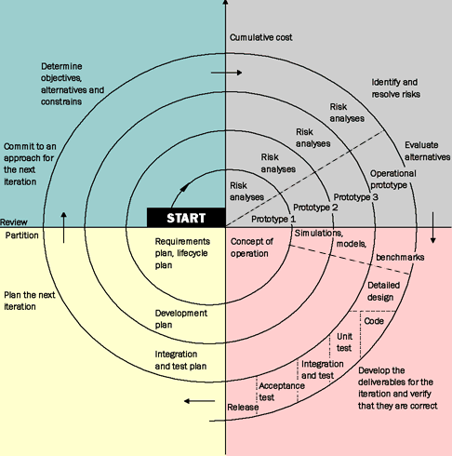
Spiral model of the software process
READ
NOTES
Notes:
This model was not the first model to discuss iteration, but it was the first model to explain why the iteration matters. As originally envisioned, the iterations were typically 6 months to 2 years long. The spiral model (Boehm, 1988) aims at risk reduction by any means in any phase. The spiral model is often referred to as a risk-driven model.
Introducing prototyping in a Software Process aims at risk reduction at the requirements level. There is always an element of risk involved in the other phases of development.
A spiral phase begins in the top left quadrant (quadrant 1), by determining objectives of that phase, alternatives and constraints. This is a way to define a strategy for achieving the goals of this iteration.
Next (quadrant 2), the strategy is analyzed form the viewpoint of risk, and solutions to minimize these risks are investigated, often using prototyping.
Then (quadrant 3), in light of the investigations made in quadrant 2, a solution is put into practice to produce the artifacts necessary to reach the goals identified in quadrant 1. This quadrant (3) corresponds to where the traditional waterfall model phases are put into practice.
Finally (quadrant4), the results of the risk-reduction strategies are assessed, and if all risks are resolved, the next phase is planned and started. If some risks are left unsolved, another iteration can be made to continue to work on the uneliminated risks. If certain risks can not be resolved, the project might be terminated immediately (under some circumstances project might be continued but in a smaller scale).

Slide 22
Spiral model quadrants
Objective setting
Specific objectives for the phase are identified.
Determining objectives of that phase, alternatives and constraints. This is a way to define a strategy for achieving the goals of this iteration
Risk assessment and reduction
Risks are assessed and activities put in place to reduce the key risks.
The strategy is analyzed form the viewpoint of risk, and solutions to minimize these risks are investigated, often using prototyping
Development and validation
A development model for the system is chosen which can be any of the generic models.
In light of the investigations made in quadrant 2, a solution is put into practice to produce the artifacts necessary to reach the goals identified in quadrant 1. This quadrant (3) corresponds to where the traditional waterfall model phases are put into practice.
Planning
The project is reviewed and the next phase of the spiral is planned.
The results of the risk-reduction strategies are assessed, and if all risks are resolved, the next phase is planned and started

Slide 23
Spiral Model Analysis
Advantages
Emphasis on alternatives and constraints supports the reuse of existing solutions.
Maintenance is just another phase of the spiral model. It is treated in the same way as development.
Estimates (budget and schedule) get more realistic as work progresses, because important issues are discovered earlier.
It is more able to cope with the (nearly inevitable) changes that software development generally entails.
Disadvantages
Only intended for internal projects (inside a company), because risk is assessed as the project is developed. Hardly suitable for contractual software development.
In case of contractual software development, all risk analysis must be performed by both client and developers before the contract is signed and not as in the spiral model.
Spiral model is risk driven. Therefore it requires knowledgeable staff.
Suitable for only large scale software development. Does not make sense if the cost of risk analysis is a major part of the overall project cost.

Slide 24
Generic Process Activities
Software specification
Software design and implementation
Software validation
Software evolution

Slide 25
Software specification
The process of establishing what services are required and the constraints on the system’s operation and development.
Requirements engineering process
Requirements elicitation and analysis;
Feasibility study
Requirements specification;
Requirements validation.

Slide 26
The requirements engineering process

Slide 27
Software design and implementation
The process of converting the system specification into an executable system.
Software design
Design a software structure that realises the specification;
Implementation
Translate this structure into an executable program;
The activities of design and implementation are closely related and may be inter-leaved.

Slide 28
Design process activities
Architectural design
Designing Subsystems which making up the system and their relationship
Abstract specification
Abstract specification of the services that each subsystem provide
Interface design
Designing Interface of each subsystem which connects it to other subsystems (provide / consume)
Component design
Allocating Services to components and designing the interfaces of these components
Database design
Designing Data structures used in the implementation of the system
Algorithm design
Designing Algorithms used to provide services

Slide 29
The software design process

Slide 30
Structured methods
Systematic approaches to developing a software design.
The design is usually documented as a set of graphical models.
Possible models
Object model;
Sequence model;
State transition model;
Structural model;
Data-flow model.

Slide 31
Programming and debugging
Translating a design into a program and removing errors from that program.
Programmers carry out some program testing to discover faults in the program and remove these faults in the debugging process.

Slide 32
Software validation
Verification and Validation (V & V) is intended to show that a system conforms to its specification and meets the requirements of the system customer.
Verification
Are we building the product right?
Validation
Are we building the right product?
Involves checking and review processes and system testing.
System testing involves executing the system with test cases that are derived from the specification of the real data to be processed by the system.
Notes:
Ver. Does the system meats its specification?
Val. Is the spec correct?

Slide 33
The testing process

Slide 34
Testing stages
Component or unit testing
Individual components are tested independently;
Components may be functions or objects or coherent groupings of these entities.
System testing
Testing of the system as a whole. Testing of emergent properties is particularly important.
Acceptance testing
Testing with customer data to check that the system meets the customer’s needs.

Slide 35
Testing phases

Slide 36
Software evolution
Software is inherently flexible and can change.
As requirements change through changing business circumstances, the software that supports the business must also evolve and change.
Demarcation between development and evolution (maintenance) ???
Although there has been a demarcation between development and evolution (maintenance) this is increasingly irrelevant as fewer and fewer systems are completely new.

Slide 37
System evolution

Slide 38
Key points
Software processes
are the activities involved in producing and evolving a software system.
Software process models
are abstract representations of these processes.
General activities
are specification, design and implementation, validation and evolution.
Generic process models
describe the organisation of software processes. Examples include the waterfall model, evolutionary development and component-based software engineering.
Iterative process models
describe the software process as a cycle of activities.

Slide 39
Key points
Requirements engineering
is the process of developing a software specification.
Design and implementation
processes transform the specification to an executable program.
Validation
involves checking that the system meets to its specification and user needs.
Evolution
is concerned with modifying the system after it is in use.

